Slide 1
Clap Control Home Automation
MADSE21.1F-003 C O JAYAWARDANA
MADSE21.1F-029 AAYSHA A NIZAR
MADSE21.1F-038 K F RISHADHA
MADSE21.1F-040 V G SADEEPA JAYAMAL

Slide 2
CONTENT
Circuit Components
Introduction
Features of the product
Circuit
Diagram
Conclusion
Limitations of product
Video Demonstration
Recommendations

Slide 3
Introduction
A circuited switch, which operates with the sound of clapping hands, where the switch comes to ‘on’ position when clapped once and to ‘off’ position when again clapped once. Furthermore, A clap-switch circuit is a sound sensitive circuit. The operation of the circuit is simple. Clap and the lamp turn on. Clap again and it turns off. The condenser microphone picks up the sound of your claps. It produces a small electrical signal which is amplified by the succeeding transistor stage. This circuit can switch on and off a light or any electric appliance by the sound of a clap. This working of this circuit is based on amplifying nature of the transistor, switching nature of transistor, relay as an electronic switch.

Slide 4
Features of the product
The main benefit of clap switch is, we can control any electric load like light, a fan from any place in the room by just clapping our hands.
It provides good output efficiency.
It is an advantageous technology for mobility-impaired person
Automatically controls lights within a specified range by clapping action
Energy efficient
Low cost
Reliable circuit
Complete elimination of manpower
High Accuracy

Slide 5
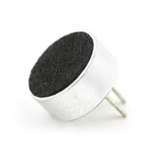
Circuit Components
Condenser Mic
Condenser Microphone is similar to an Amplifier. It is an acoustic-to-electric transducer or sensor that converts sound into an electrical signal..Also known as capacitor /electrostatic microphone
Here, the diaphragm acts as one plate of a capacitor, and the vibrations produce changes in the distance between the plates. The voltage maintained across the capacitor plates changes with the vibrations in the air, In this circuit, the condensor mic gives the main input for the circuit to start functioning.

Slide 6
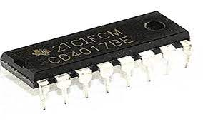
IC 4017
The IC CD 4017 is a decade counter that counts to ten. It has 10 outputs that represent the numbers 0 to 9. The counter increases with one for every rising clock pulse. After the counter has reached 9, it starts again from 0 with the next clock pulse.
The easiest way to create a decade counter is by connecting 10 D flip-flops in series to create a shift register. Then you connect the output of the last flip-flop back to the input of the first. The CD4017 however uses a technique called a Johnson Counter that makes it possible to achieve the same with only 5 flip-flops plus some logic gates.

Slide 7
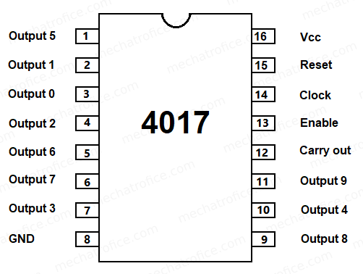
The Pin Diagram Of IC 4017

Slide 8
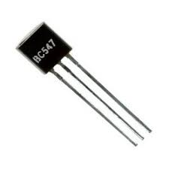
Transistor BC547
Its an npn transistor used for general purposes.
BC547 is usually used for a current amplifier, quick switching, and pulse-width modulation (PWM).
We had used two transistors to amplify the electric pulse converted by the condensor .

Slide 9
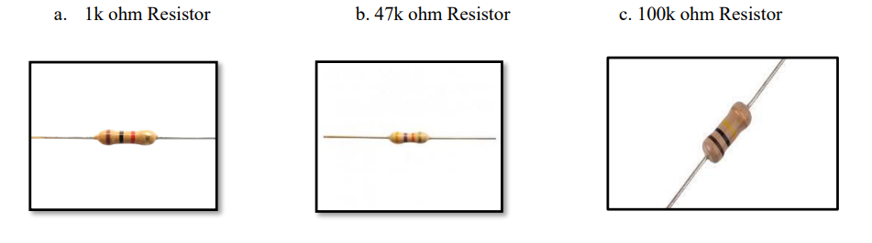
Resistors (1k, 1k, 100k ohm)
They are electric components that oppose the flow of current or prevent excess leakage of current in the circuit when required.

Slide 10
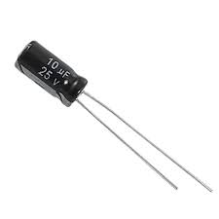
Capacitor (10uF)
Capacitors – They are passive components that store a small amount of charge. These devices stores electrical energy in an electric field. These passive electronic components are composed of two terminals.

Slide 11
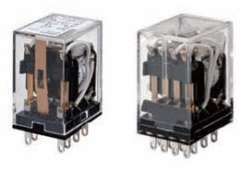
Relay
A relay is an electrically operated switch. It consists of a set of input terminals for single or multiple control signals and a set of operating contact terminals.
Relays control one electrical circuit by opening and closing contacts in another circuit.
Relays are used where it is necessary to control a circuit by an independent low-power signal, or where several circuits must be controlled by one signal. Relays were first used in long-distance telegraph circuits as signal repeaters: they refresh the signal coming in from one circuit by transmitting it to another circuit.

Slide 12
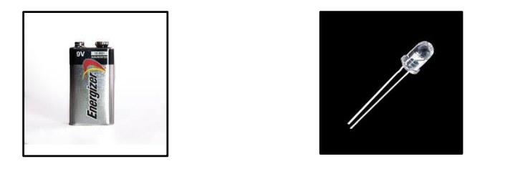
LED and Battery (5-9v)
Battery provides power and stores energy and then discharges it by converting chemical energy into electricity.
LED is used to radiate light when power is supplied

Slide 13
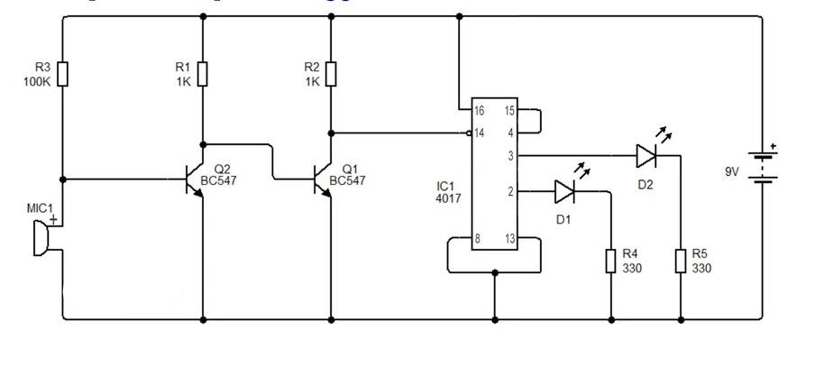
Basic Circuit Diagram

Slide 14
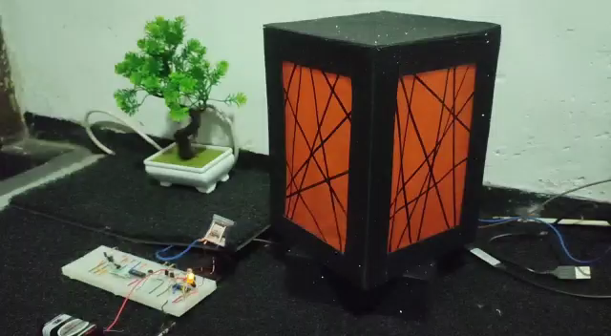
Video Demonstration on how the circuit works

Slide 15
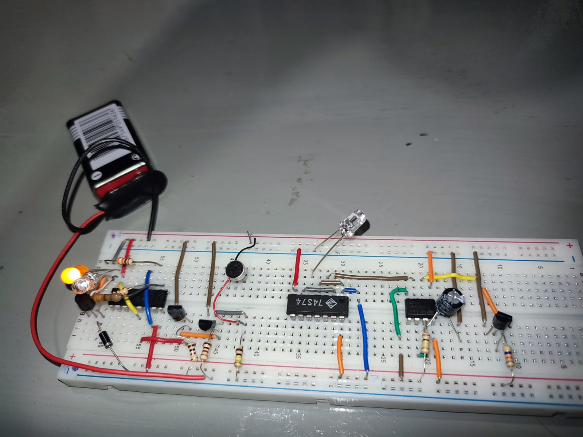
Circuit Image

Slide 16
Benefits of the Product
The major advantage of a clap switch is that you can turn something (ex: a lamp) on and off from any location in the room (ex: while lying in bed) simply by clapping your hands. The primary application involves an elderly or mobility-impaired person. A clap switch is generally used for a light, television, radio, or similar electronic device that the person will want to turn on/off from bed. There is a further scope of work on this project. This circuit is an energy-efficient, Low cost and reliable circuit with Complete elimination of manpower and High Accuracy. This circuit can be made more accurate and more sensible to suit practical use in our daily lives.

Slide 17
Limitations of the product
No filter has been used here so the switch will respond to more or less every two sounds similar to clapping.
We need to clap loudly to test this circuit as this small condenser mic doesn’t have a long range.
No relay is been used here.
External sounds similar to the sound of clapping may also make the circuit work.

Slide 18
Recommendations
If a relay is used, we can extend the circuit to connect further devices for further usage of the clap switch.
But if a simple bandpass filter is used then the problem of being unable to differentiate a clap sound from other sounds could be avoided.
The frequency range of hand-clapping is between 2200 and 2800 Hertz. Therefore, to add more sensitivity to the switch, the sensitivity of the microphone may be increased. For this, we can use a proper value of Pull-Up resistor with the mic or use a variable resistor and try different values or use different microphones.

Slide 19
Conclusion
This circuit is very useful in the field of electronic circuits. Using some modifications its area of application can be extended to various fields. It can be used to raise alarms in a security system with noise, and also used in the place where silence is needed. This project gives us a great deal of knowledge about the IC 4017, the working of counters, and the relay. This switch is very low cost and is very useful to the elderly and physically challenged people. However, the major disadvantage of this switch is false triggering. The switch can be triggered by any two sounds similar to that of hands clapping. So good care has to be taken to avoid this kind of false triggering and the switch should not be used in very sensible applications. It is only for home uses. Nevertheless, it is an excellent example of electronics evolution and how engineering and electronics have made our life easier. In the future, this system or technique will be helpful in every industry in every aspect

Slide 20

Thank you!

